Slide 1
Report
May-2022 MP Inspection BFX – UA300
Date : 05-July-2022
Prepared by: Rachel Ruan

Slide 2
Issue Description
30-June-2022, ALT customer complain [BFX-UA300] 24-May-2022 to 27-May-2022 Mass production issue.
Overall inspection result => Fail ( Waived, due to product launch schedule )
Defect Total:
•Critical
Status LED not work * 1 pcs
Ethernet unstable * 1 pcs
No sound output * 1 pcs
•Major
No screen after booting animation. * 1 pcs
Cosmetic damage * 1 pcs
•Minor
Screw assembly * 1 pcs
Tact feeling is not good * 1 pcs

Slide 3
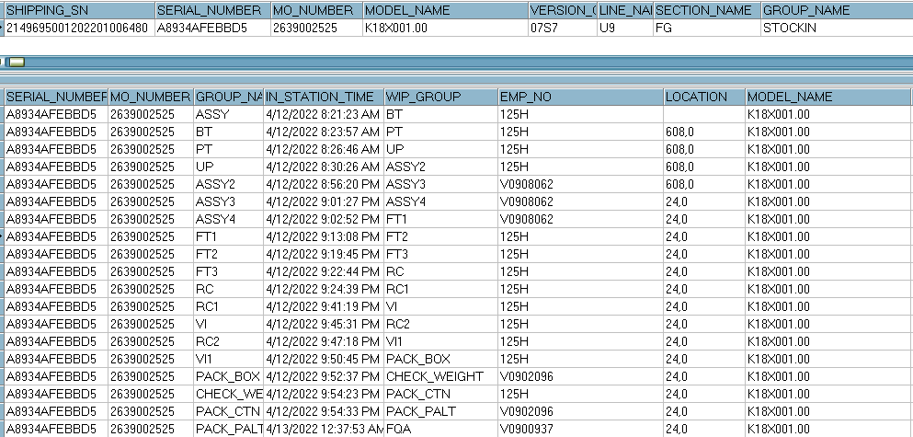
1. LED not work
Issue Description | FA | Root cause | Actions | Owner | Due Date | Status
Symptom: Led not work Type: Critical Defect unit Q’ty : 1/200pcs Defect rate : 0.5% SKB SN: 2149695001202201006480 | 1. Fail symptom: As ALT feedback that they found out 1pcs LED is not working 2. Check FATP data → product pass normally →On FATP : LED function tested at FT1 station (With factory software) and RC1 station ( With customer software) This issue can cover on FATP 3. Suggestion - Check connection of FFC cable ( connection between K18X001T00 main board and 96.1515T00 LED main board) - Measure power voltage on main Led: VCC5.0V, VCC3.3V , VLED3.3V - Measure impedance , voltage diode, voltage on Led ( Pin1: Led Red, Pin2: Led Green, Pin3: Led Blue, Pin4: LED_PWR) → check the operation of led by each color | ➔ Waiting NG sample for Further analysis | → Require ALT send NG sample to Factory for analysis | PE: Mr. Thuc | 07/20

Slide 4
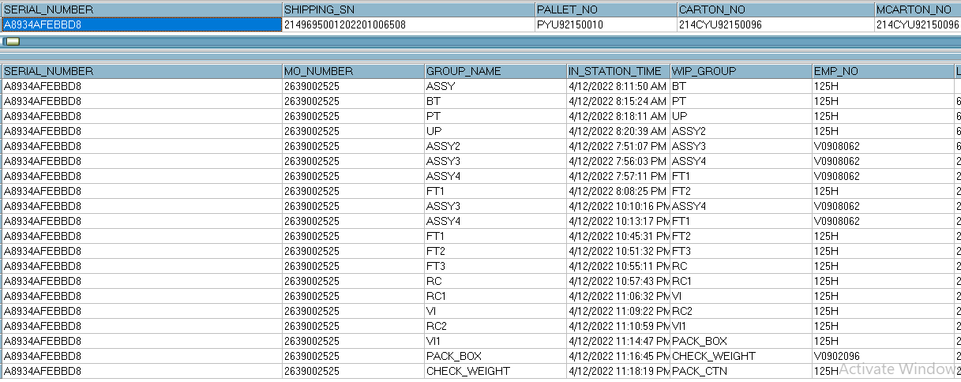
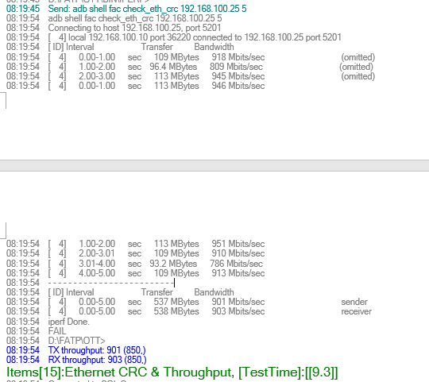
2. Ethernet unstable
Issue Description | FA | Root cause | Actions | Owner | Due Date | Status
Symptom: Ethernet unstable Type: Critical Defect unit Q’ty : 1/200pcs Defect rate : 0.5% SKB SN: 2149695001202201006508 | 1. Fail symptom: As ALT feedback that they found out 1pcs Ethernet unstable (Ethernet link up is OK, but more than 50% packet loss occurred) 2. Check FATP data → pass normally - At PT station: test program will test Ethernet CRC and throughput → This issue can cover at PT station 3. Suggestion - Check connection between RJ45 port and Ethernet cable - Measure impedance, voltage in U801 (Ethernet Precision Transceiver) location - Use oscilloscope to measure crystal frequency (Y801) | ➔ Waiting NG sample for Further analysis | → Require ALT send NG sample to Factory for analysis | PE: Mr. Thuc | 07/20

Slide 5
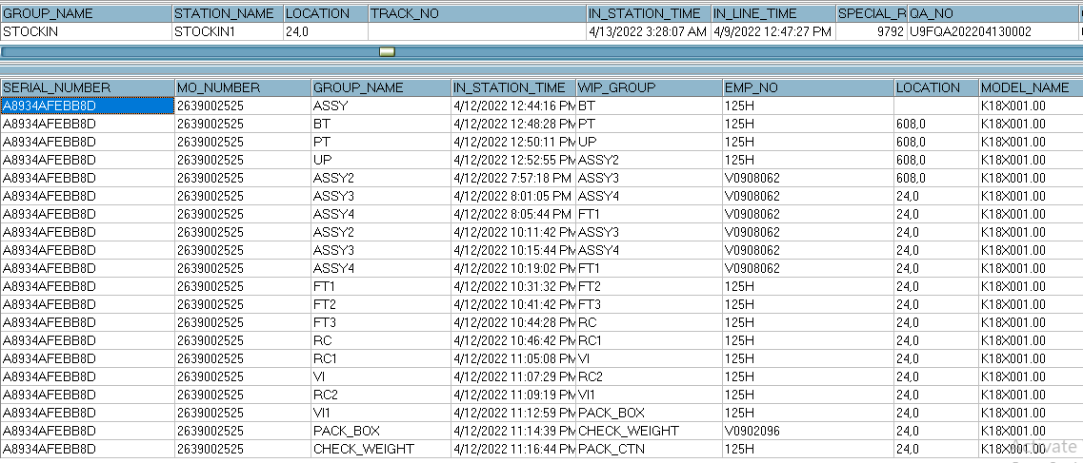
3. No sound output
Issue Description | FA | Root cause | Actions | Owner | Due Date | Status
Symptom: No sound output Type: Critical Defect unit Q’ty : 1 / 200pcs Defect rate : 0.5% SKB SN: 2149695001202201006507 | 1. Fail symptom: As ALT feedback that they found out 1pcs No sound output 2. Check FATP data → pass normally →On FATP : Sound function tested at FT2 station (With factory software) and RC1 station ( With customer software) This issue can cover on FATP 3. Suggestion - Check connection of FFC cable ( connection between K18X001T00 main board and 96.1531T00 AMP main board) - Measure power supply voltage: U2 (VCC5V), U3(VDDA0_3.3V, U51( 0.86-1.14V), U52(0.81-1.09V), U53(1.35V), U55(1.8V) - Measure impedance , voltage in U201, U301 ( Control 2 woofers) and U202, U302 (Control 2 full range speaker) location | ➔ Waiting NG sample for Further analysis | → Require ALT send NG sample to Factory for analysis | PE: Mr. Thuc | 07/20

Slide 6
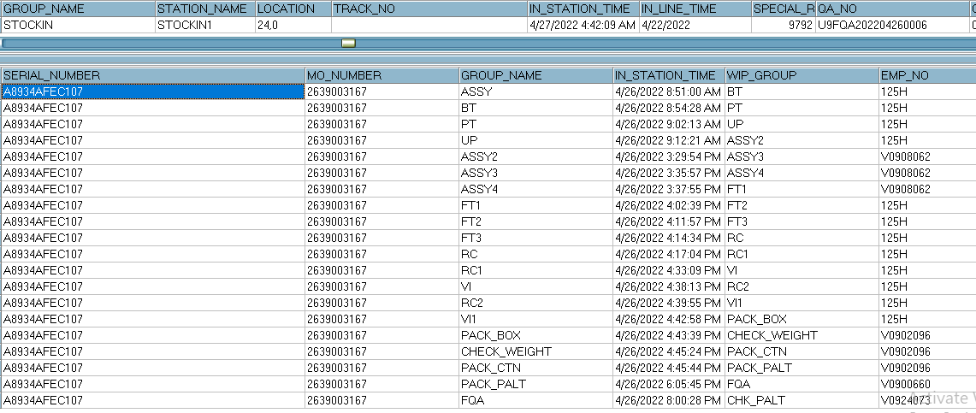
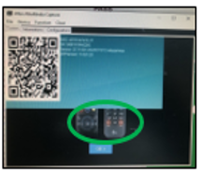
4. No screen after booting animation
Issue Description | FA | Root cause | Actions | Owner | Due Date | Status
Symptom: No screen after booting animation Type: Major Defect unit Q’ty : 1/200pcs Defect rate : 0.5% SKB SN: 2149695001202201007918 | 1. Fail symptom: As ALT feedback that they found out 1pcs No screen after booting animation 2. Check FATP data → pass normally →At RC1, RC2 station : test program will check QR code and display remote capture when product finish booting as the picture bellowing: → This issue can cover at RC1, RC2 station | → This issue has happened before and Customer FW: 19.532.16 has bug. → Confirmed with RD and customer this issue and they still not provide method to fix it. | Short term: - Factory will re- download customer FW 19.532.16 to solve this case. Long term: - Continue to work with RD to find a method to fix this issue | PE: Mr. Thuc RD: Mr. Dean PQE: Ms. Rachel PM: Mr. An | 07/20

Slide 7
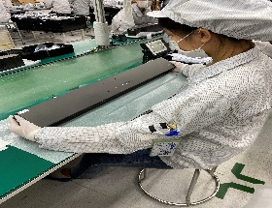
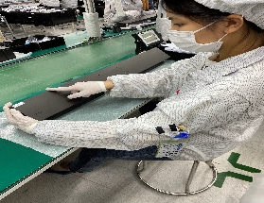
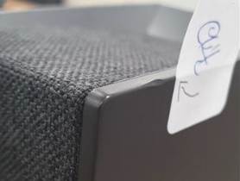
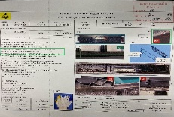
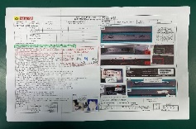
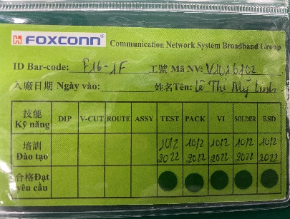
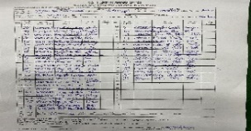

5. Cosmetic damage
Issue Description | Root Cause | Actions | Owner | Due Date | Status
Symptom : Dented on the side of the top case Type: Major Defect unit Q’ty : 1/200 pcs Defect rate : 0.5% | The May-2022, online had defect Top housing had damage when OP open housing carton check visual before assembly. We had inform to Inkel vendor notice this issue and request Inkel sorting before ship to Fii. On production line, OP no check careful housing TOP case had damage. 3. Visual Inspection station: OP - V1001210 Nguyen Thi Hong -Line 9. | 1. Re-training OP check housing incoming and assembly , VI . Status : Done 2. Update NG picture to SOP and Hang quality arlam on this station for OP notice it. Status : Done 3. Before run line , line leader training OP, notice quality online issue, IPQC defect issue, OBA issue, read SOP and quality alarm. Status : Done | PQE:Rachel IE: Mei Ling PD:Van Anh ME: Cheng Lun SQE: Mouse | 02-July

Slide 8
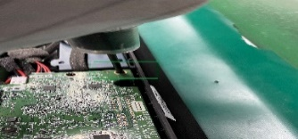
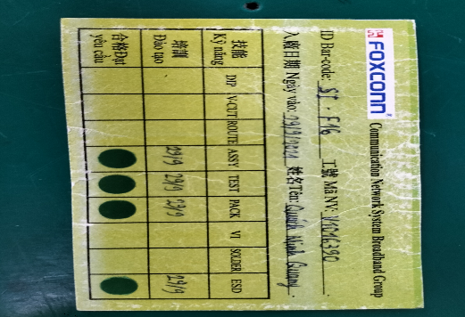
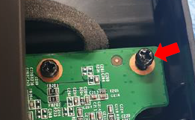
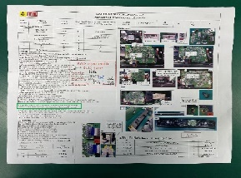
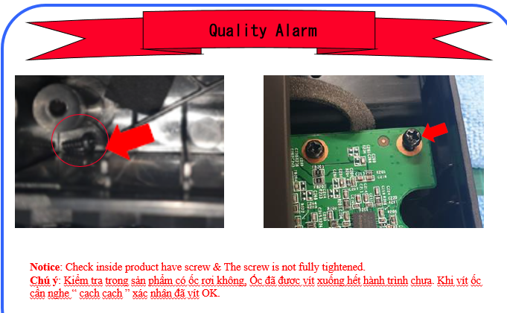
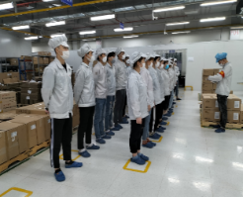
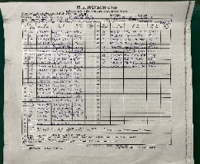
6. Screw assembly
Issue Description | Root Cause | Actions | Owner | Due Date | Status
Symptom : The screw is not fully tightened Type: Minor Defect unit Q’ty : 1/200 pcs Defect rate : 0.5% | 1. OP assembly AMP main doing no follow SOP, Screw need confirm by 2 “cach cach”. 2. OP no re-check by himself before transfer to next station. 3. OP doing this station : V1016390 Quach Minh Quang. | 1. Re-training OP doing follow SOP. Status : Done 2. Update NG picture to SOP. Quality alarm hang online for OP notice it. Status : Done 3. Before run line , line leader training OP, notice quality online issue, IPQC defect issue, OBA issue, read SOP and quality alarm. Status : Done | PQE:Rachel IE: Mei Ling PD:Van Anh ME: Cheng Lun SQE: Mouse | 02-July

Slide 9
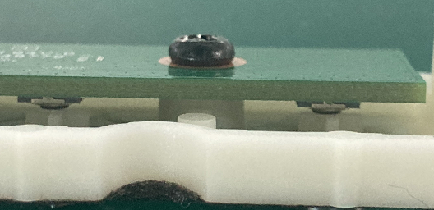
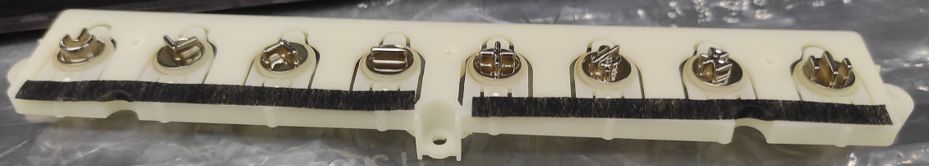
7. Tact feeling is not good
Issue Description | FA | Root cause | Actions | Owner | Due Date | Status
Symptom : Power button tact feeling is NG Type: Minor PCBA check : one tact switch feels NG in PCBA level. | 1. Fail symptom: As ALT feedback that they found out 1pcs tact feeling is not good 2. Check FATP data SN ➔ Pass normally. 3.ME checking this issue and doubts power button incoming was abnormal resulting in a bad feel when the button is operated. | ME check big gap between power button and switch of 96.1517T00 board. ME doubts the power button incoming have abnormal so to when press will have feeling no good. This problem abnormal found when the material incoming was deformed. | Short term: + Feedback SQE problem abnormal of material incoming. +After assembly Top cover and key board will confirm the status of the all push button before assembling Housing. Long term: + Update SOP problem feeling button checking inspection of standard. + Training station VI inspection to checking distinguish feelings not good and confirm with QA. | ME : Mr. Huy RD: Mr. Dan PQE: Ms.Rachel PM: Mr. An SQE : Mr. Sy | 02-July
Deformed
NG
OK

